Slide 1

Simon Says

Slide 2
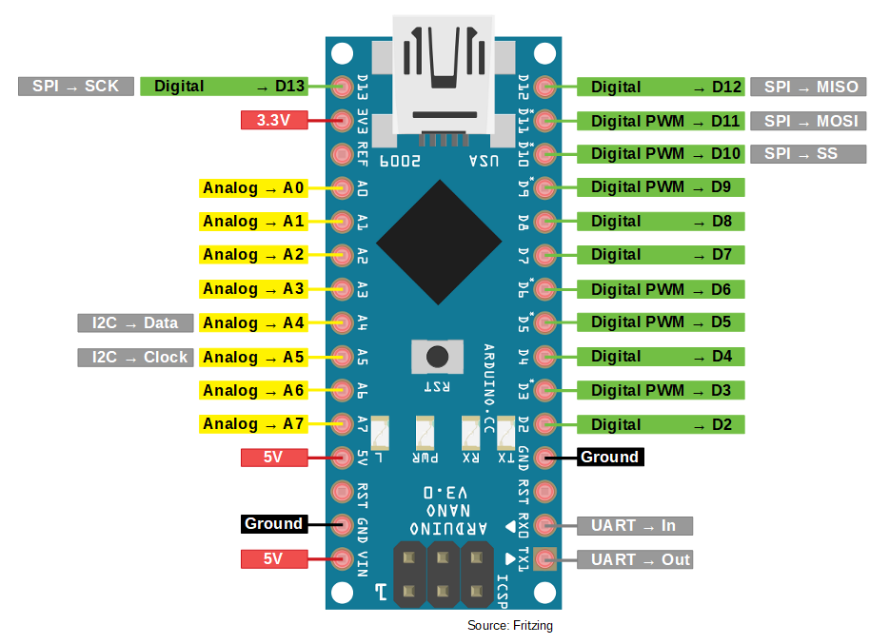
What is a Microcontroller?
The Arduino you will be using today is a type of Microcontroller! But what is a Microcontroller?
A microcontroller is the main chip embedded inside of a larger system (the arduino in this case) with the intent to control a singular function in a device. It does this by interpreting data it receives from its I/O pins.
The information that the arduino receives is stored in its data memory, where the microcontroller can access it and use the instructions the user has programmed into it to decipher and apply the incoming data. It then uses its I/O pins to communicate and enact the actions the user instructed it to do.

Slide 3
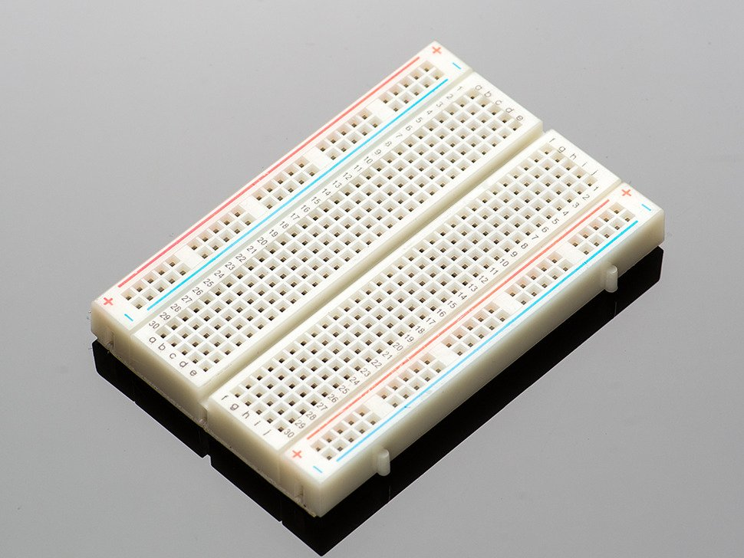
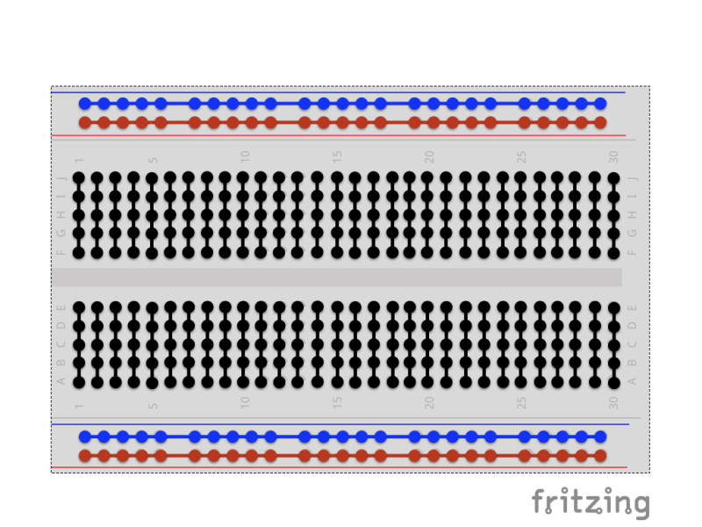
Breadboarding Basics
A breadboard is a tool used for prototyping circuits. Instead of having to permanently solder wires to a circuit board, wires can be easily plugged in and pulled out of the breadboard. They are perfect for working with Arduino Nanos because the Nano can be plugged directly into the breadboard.
On either side of the breadboard, there are positive and negative terminals that are used to power and ground the components of your circuit. These positive and negative terminals work in vertical tandem. The central rails are connected horizontally like seen in the picture on the right. The line dividing the breadboard in two separates the electrical connections on either side of the board.
With that being said, you can think of all the connected rails as wires you can tap into at anytime. Just plug something into a rail and it becomes connected to everything else that’s connected to that rail!

Slide 4
Inventory
5x Buttons
5x 10k Ohm Resistors
4x 1k Ohm Resistors
4x LEDs
6x Black Wires
3x Red Wires
3x Blue Wires
2x Green Wires
2x Red Wires
2x Yellow Wires
1x Arduino Nano + Breadboard

Slide 5
LED Tutorial

Slide 6
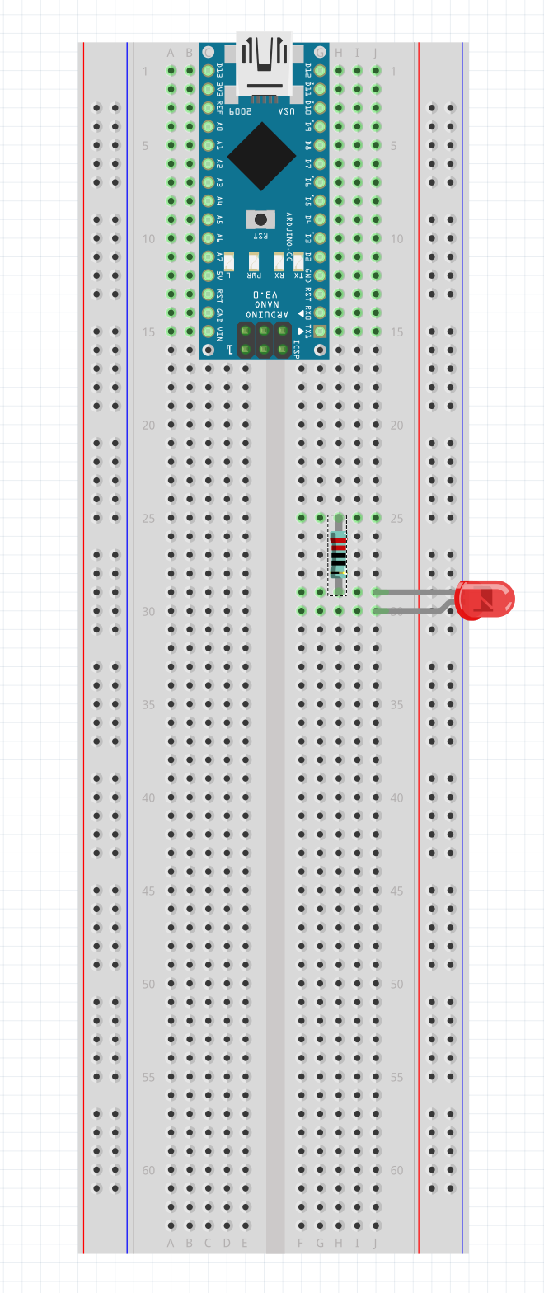
Step 1
Place the LED:
The short side: J29
The long side: J30
Place the 1k resistor (the blue one):
H25, H29

Slide 7
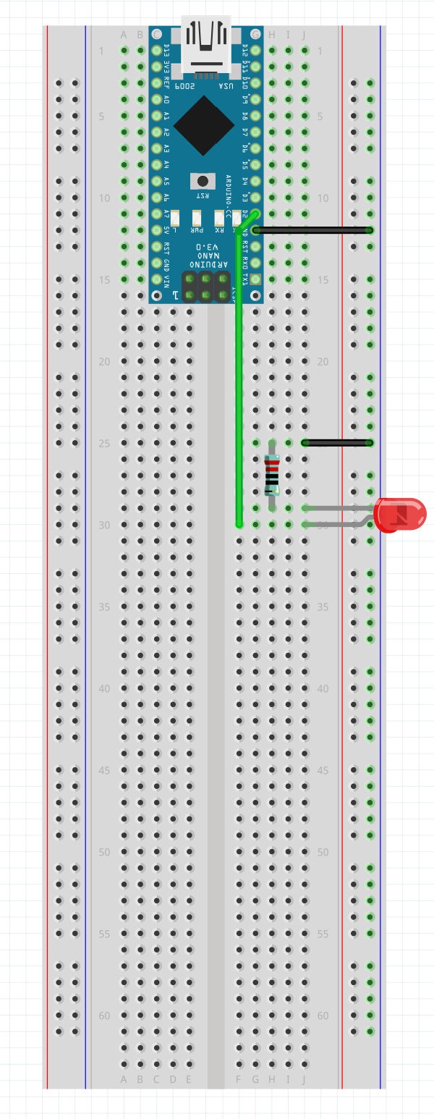
Step 2
Place the Green Wire:
I11, F30
Place the two Ground (Black) wires:
I12, Left Minus 12
J25, Left Minus 25

Slide 8
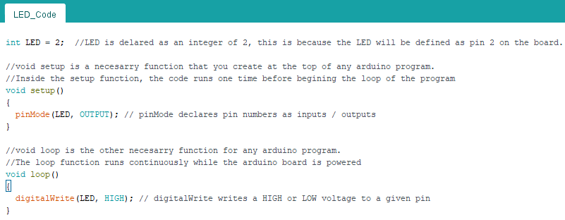
Learn to Code!

Slide 9
Button Tutorial

Slide 10
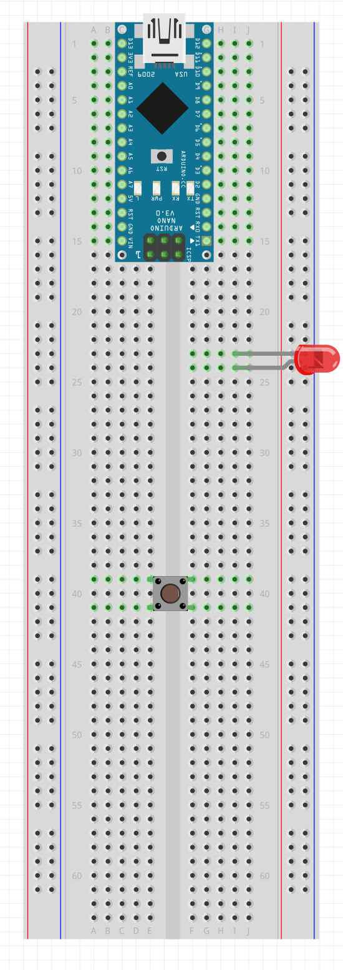
Step 1
Place the LED:
The short side: I23
The long side: I24
Place the button:
E39, E41, F39, F41

Slide 11
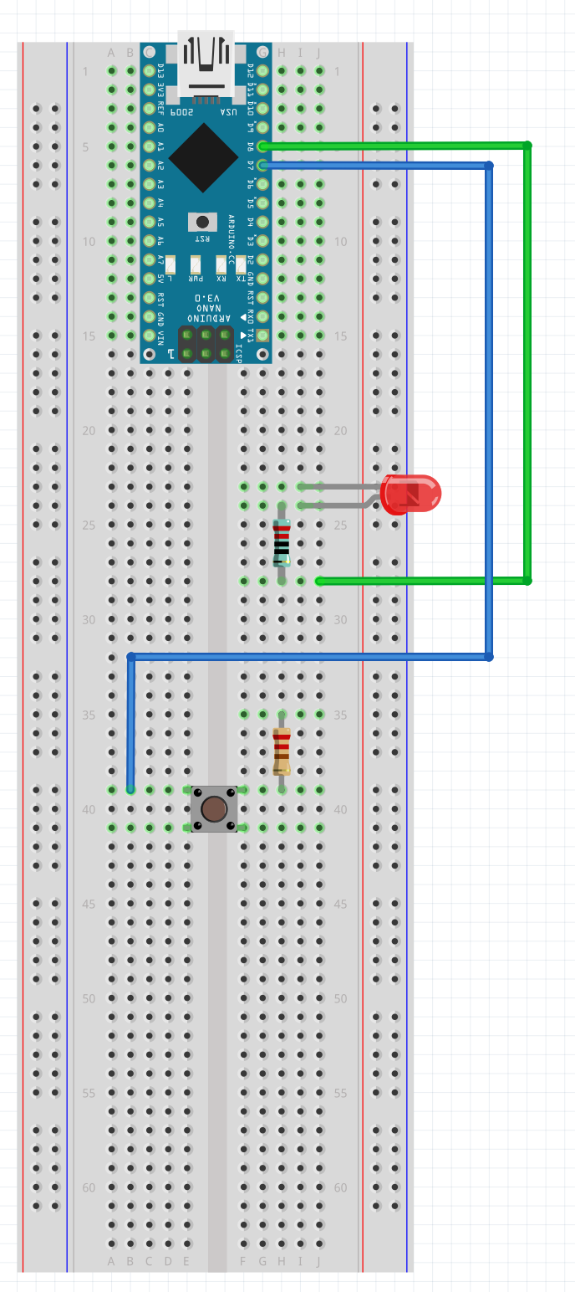
Step 2
Place the data wires:
Green: I5, J28
Blue: I6, B39

Slide 12
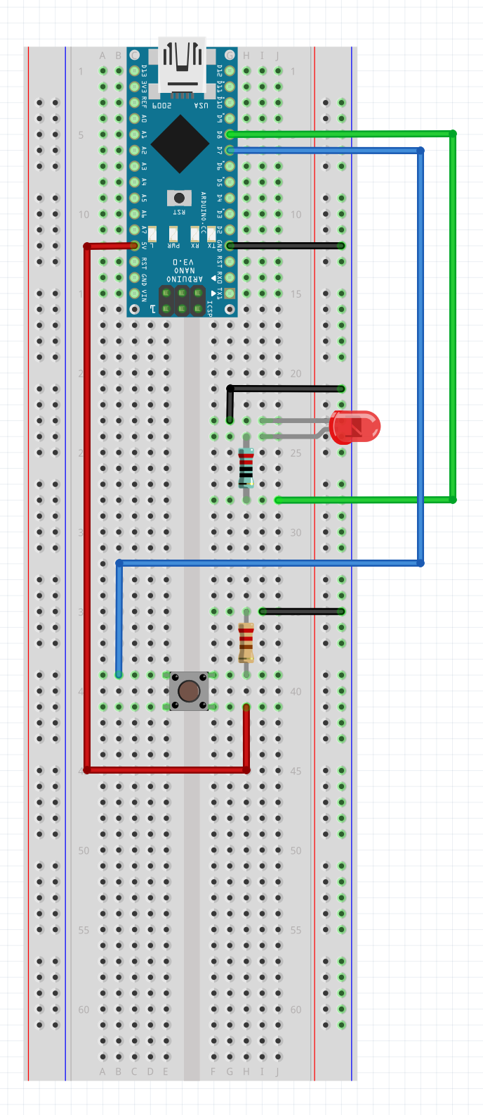
Step 3
Place the Ground (Black) wires:
I12, Left Minus 12
G24, Left Minus 23
I35, Left Minus 35

Slide 13
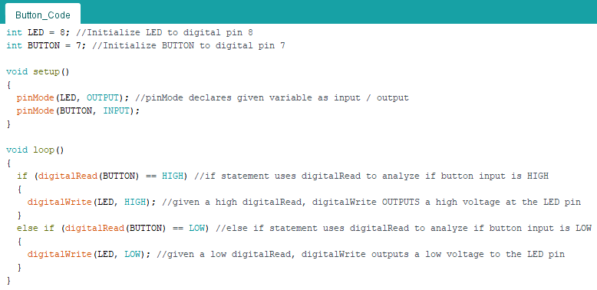
Learn to Code!

Slide 14
Some important things to note before you get started
The 1k resistors are the blue ones, and they connect to the LEDs
The 10k resistors are the yellow ones, and they connect to the buttons
The long side of the LED is the positive side (the anode), and should connect to the resistor. Where as the short side (the cathode) should connect to the button.
In the schematic on the next slide, it uses a different type of arduino, an arduino uno. This doesn’t make a difference to any of the circuitry, and you will be plugging in the wires to the I/O pins with the same names on the Nano.
When this powerpoint references “right/left, plus/minus, column” , this correlates with the two sets of plus or minus columns on either side of the board. When we say right, this is the right column when the arduino is on the side of the breadboard closer to you.

Slide 15
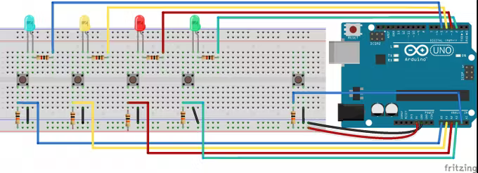
Schematic
**Note: We flipped the layout. Analog and digital connections were swapped from the original schematic above. 1k resistors are in bottom layout. 10k resistors in top layout.

Slide 16
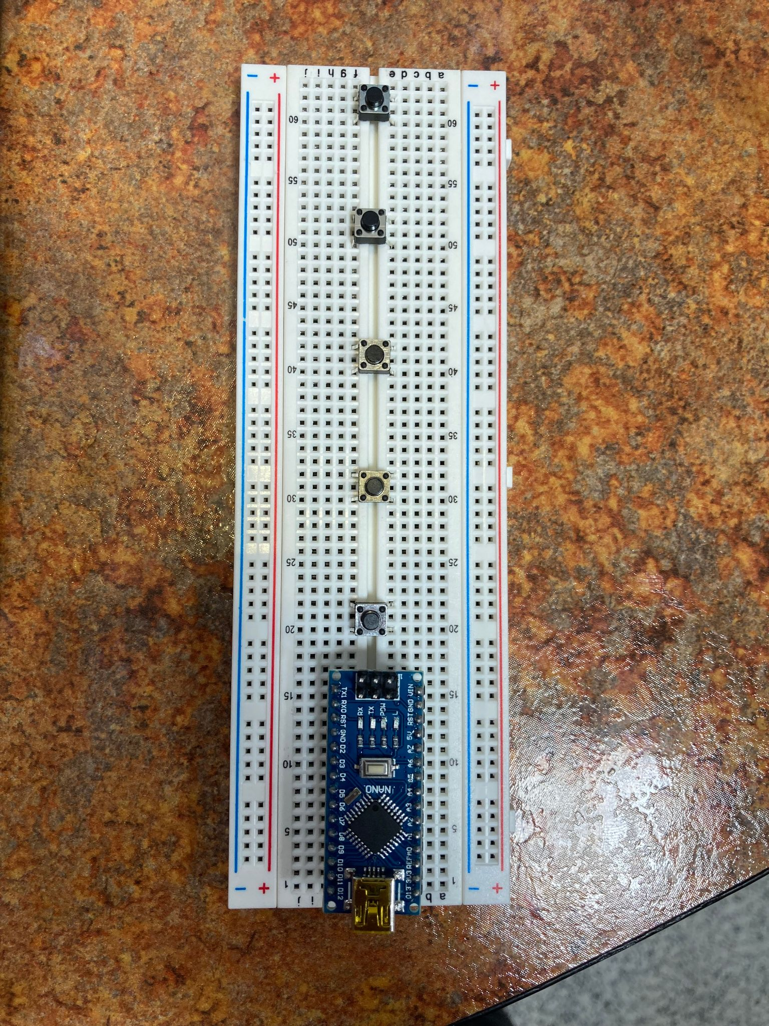
Step 1
Plug in the five buttons to:
E20, F20, E22, F22
E30, F30, E32, F32
E40, F40, E42, F42
E50, F50, E52, F52
E60, F60, E52, F62

Slide 17
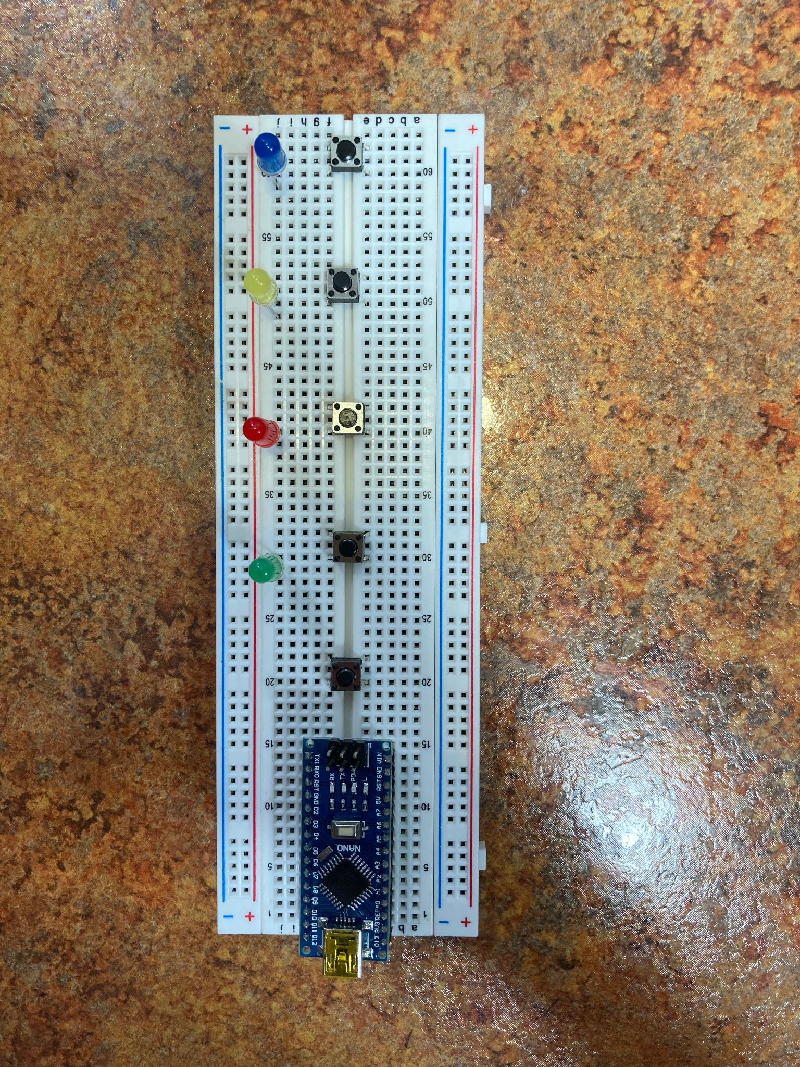
Step 2
Plug in the four LEDS:
Green: Short side J30, Long side J29
Red: Short side J40, Long side J39
Yellow: Short side J50, Long side J49
Blue: Short side J60, Long side J59

Slide 18
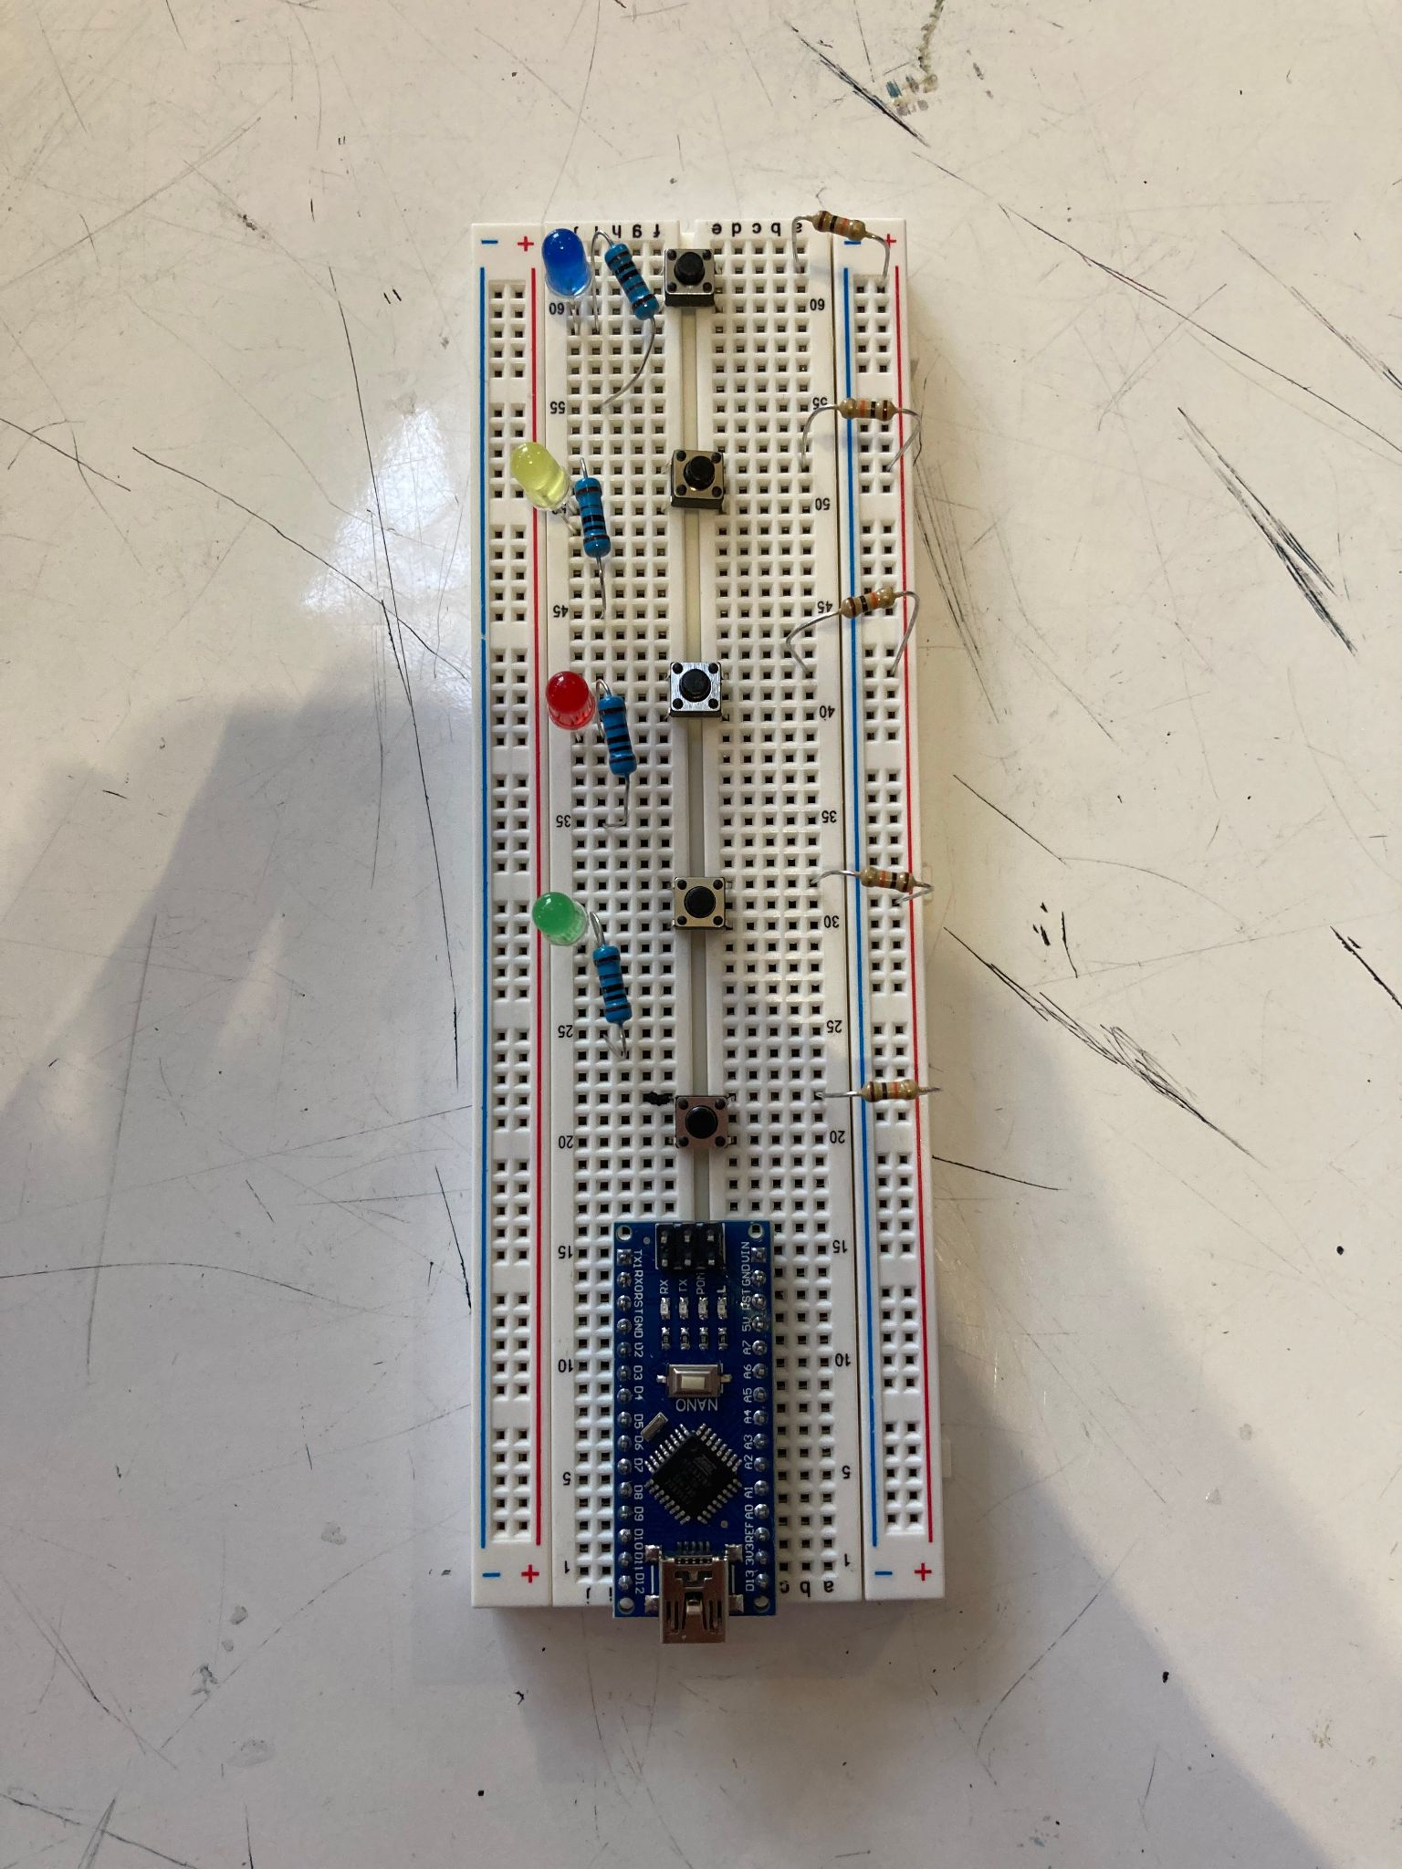
Step 3
Plug in the 1k resistors (the blue ones)
I29, I25
I39, I35
I49, I45
I59, I55
Plug in the 10k resistors (the non-blue ones)
A22, Right Positive 22
A32, Right Positive 31
A42, Right Positive 42
A52, Right Positive 52
A62, Right Positive 61

Slide 19
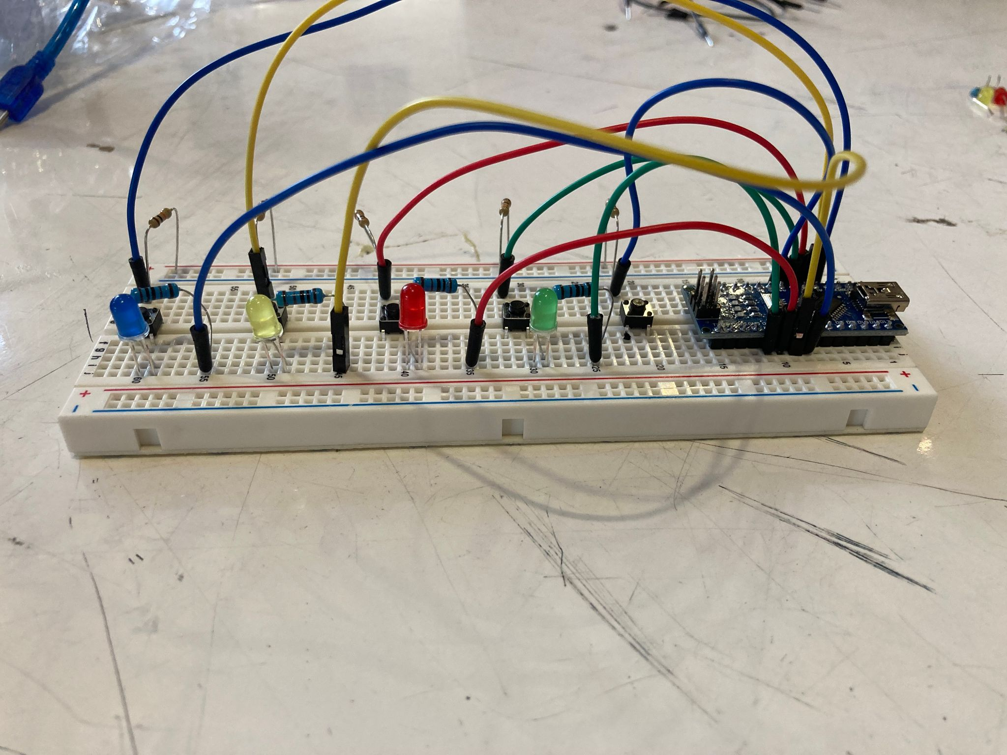
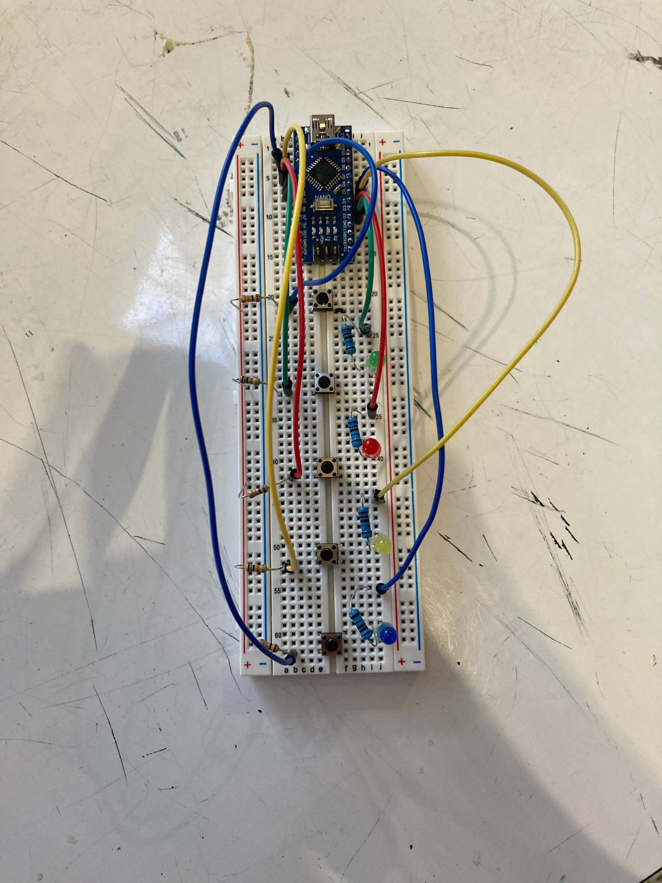
Step 4
Plug in the wires connecting the LEDs
Green: J25, I11
Red: J35, I10
Yellow: J45, I9
Blue: J55, I8
Plug in the wires connecting the buttons
Blue: B22, B8
Green: B32, B7
Red: B42, B6
Yellow: B52, B5
Blue: B62, B4

Slide 20
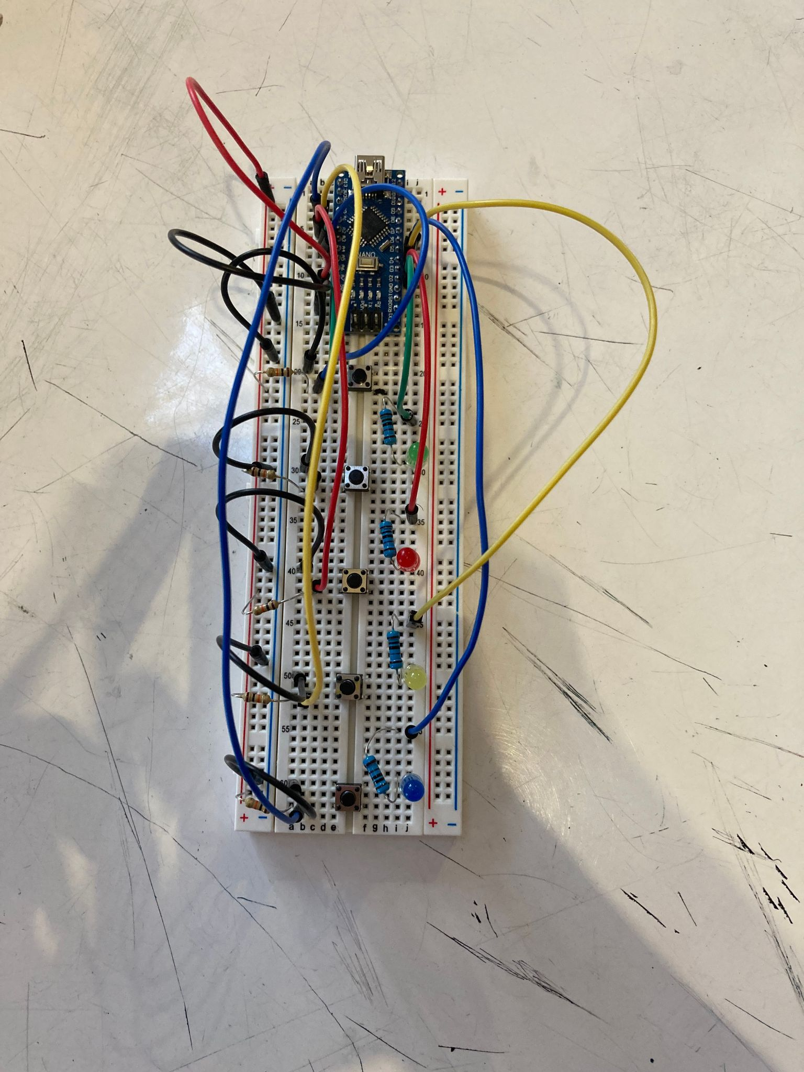
Step 5
Plug in the ground wires (black wires)
B14, Right Negative 15
A20, Right Negative 19
A30, Right Negative 30
A40, Right Negative 40
A50, Right Negative 49
A60, Right Negative 60
Plug in the power wire (extra red wire)
B12, Right Positive 12

Slide 21
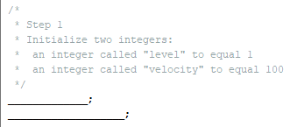
Implement the code you’ve been learning!
Step 1
Initialize two integers:
an integer called "level" to equal 1
int level = 1;
an integer called "velocity" to equal 100
int velocity = 100;

Slide 22
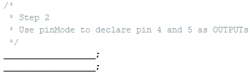
Step 2
Use pinMode to declare pin 4 and 5 as OUTPUTs
pinMode(4, OUTPUT);
pinMode(5, OUTPUT);

Slide 23
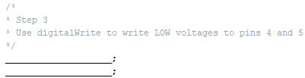
Step 3
Use digitalWrite to write LOW voltages to pins 4 and 5
digitalWrite(4, LOW);
digitalWrite(5, LOW);

Slide 24
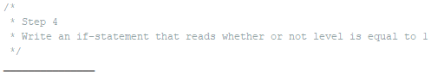
Step 4
Write an if-statement that reads whether or not level is equal to 1
if (level == 1);

